Slide 1
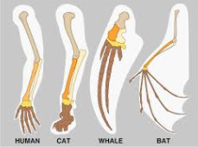
Evidence for Evolution
Comparative Studies in Anatomy
Embryology
Homologous Structures
Vestigial Structures
Geographical Distribution

Slide 2
Comparative Anatomy - Intro
Compares structural features of organisms, looking at degree of similarity and therefore relatedness.
3 areas looked at:
Embryology: comparing early embryonic development
Homologous organs: organs that are similar in structure but may be used/adapted for different conditions
Vestigial organs: organs that may once have been important by have lost function

Slide 3
Embryology
Provides evidence for evolutionary change over time
Compares early development
Embryos initially very similar between species
Differentiation occurs during development
Differences become apparent later with more closely related organisms.

Slide 4
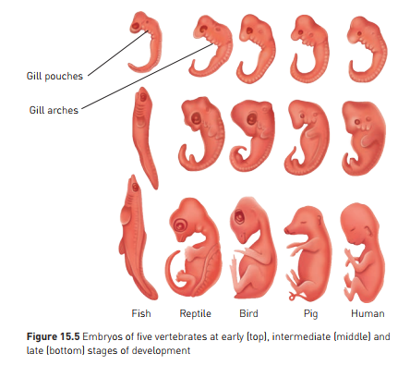
Evidence for common ancestry
Note:
All species start with similar features
Gill arches appear in all – why, if mammals don’t need them?
In humans:
One gill slit becomes the Eustachian tube (connects ear to throat)
Tissue from around other gills develops into thryoid and tonsils

Slide 5
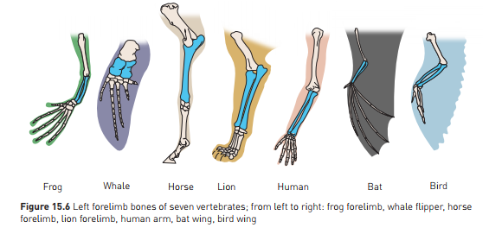
Homologous Structures
Same bones appear in a variety of different species, but are used for different functions
Illustrates common ancestry, then adaptation.

Slide 6
Example: vertebrate forelimbs
Same bones appear
Bones arranged in a similar way, but adapted in form to suit function
In pic below: forelimb bones

Slide 7
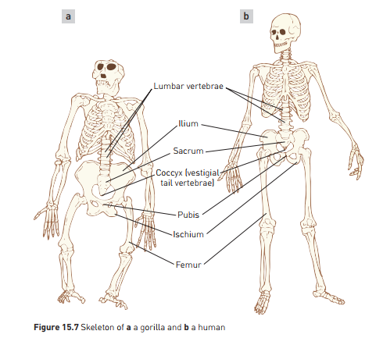
Example: Anthropoids (great apes) and Humans
High degree of similarity, even across a range of habitats
Shows that evolutionary divergence is relatively recent

Slide 8
Vestigial Organs
Structures that have no or limited use in the organism, but were of use in an ancestral form.
Evidence that the organism has evolved from an ancestor – the process isn’t perfect!
Eg:
Snakes sometimes born with vestigial limbs
Humans:
Nictitating membrane at corner of eye – used in cats, not used in humans
Wisdom teeth - some people don’t have them!
appendix

Slide 9
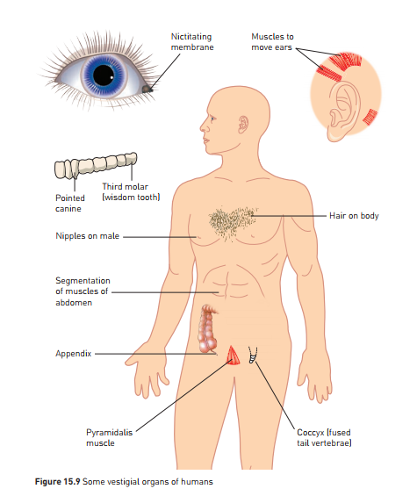

Slide 10
Geographical Distribution
Further evidence for evolution
Eg Darwin’s finches – Galapagos Islands
Finches different in the islands than South American mainland
Several finches, back in time, had travelled from mainland, by chance – blown by a storm??
As a result, no competition , so evolved to take advantage of food sources on offer on different islands
Beaks adapted to different food sources.
Eventually evolved into 13 separate species on the islands.

Slide 11
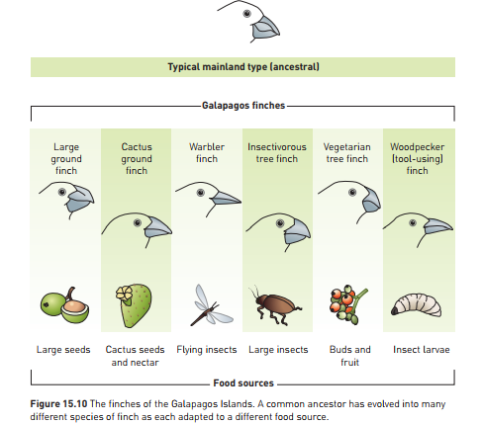

Slide 12
Galapagos finches cont…
Darwin hypothesised:
Mainland species arrived on islands and then diverged due to natural selection
First finches to arrive would have shown small, natural variations in beak shapes
Different finches would find different food sources easier to feed on – eg: one might find cactus seeds easiest to eat, another might find insect larvae easiest
Food source on individual islands would have favoured certain beak types over others, conferring a survival advantage
Birds on islands would slowly diverge in beak shape, adapting to food source on the islands.

Slide 13
Humans, Primates and evidence
Humans most resemble chimpanzees and gorillas
Therefore hypothesis that common ancestor most likely lived in place where chimps and gorillas are (Africa) rather than where lemurs or New World Monkeys are.
This has been shown to be true – discovery of ancestral fossils in African Rift Valley.

